Slide 1
Wildlands Obstacle avoidance
Anthony Herron and Mahfoudh batarfi

Slide 2
Goal
We wanted to create a game that is easy to pick up and play.
The game is supposed to be played mostly for exploring the world.
The objective in the game is to pickup as many gems as you can within the time frame.

Slide 3
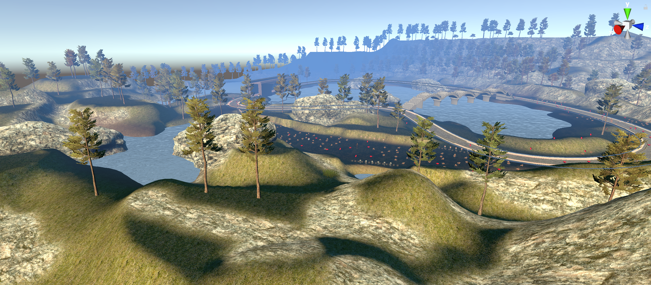
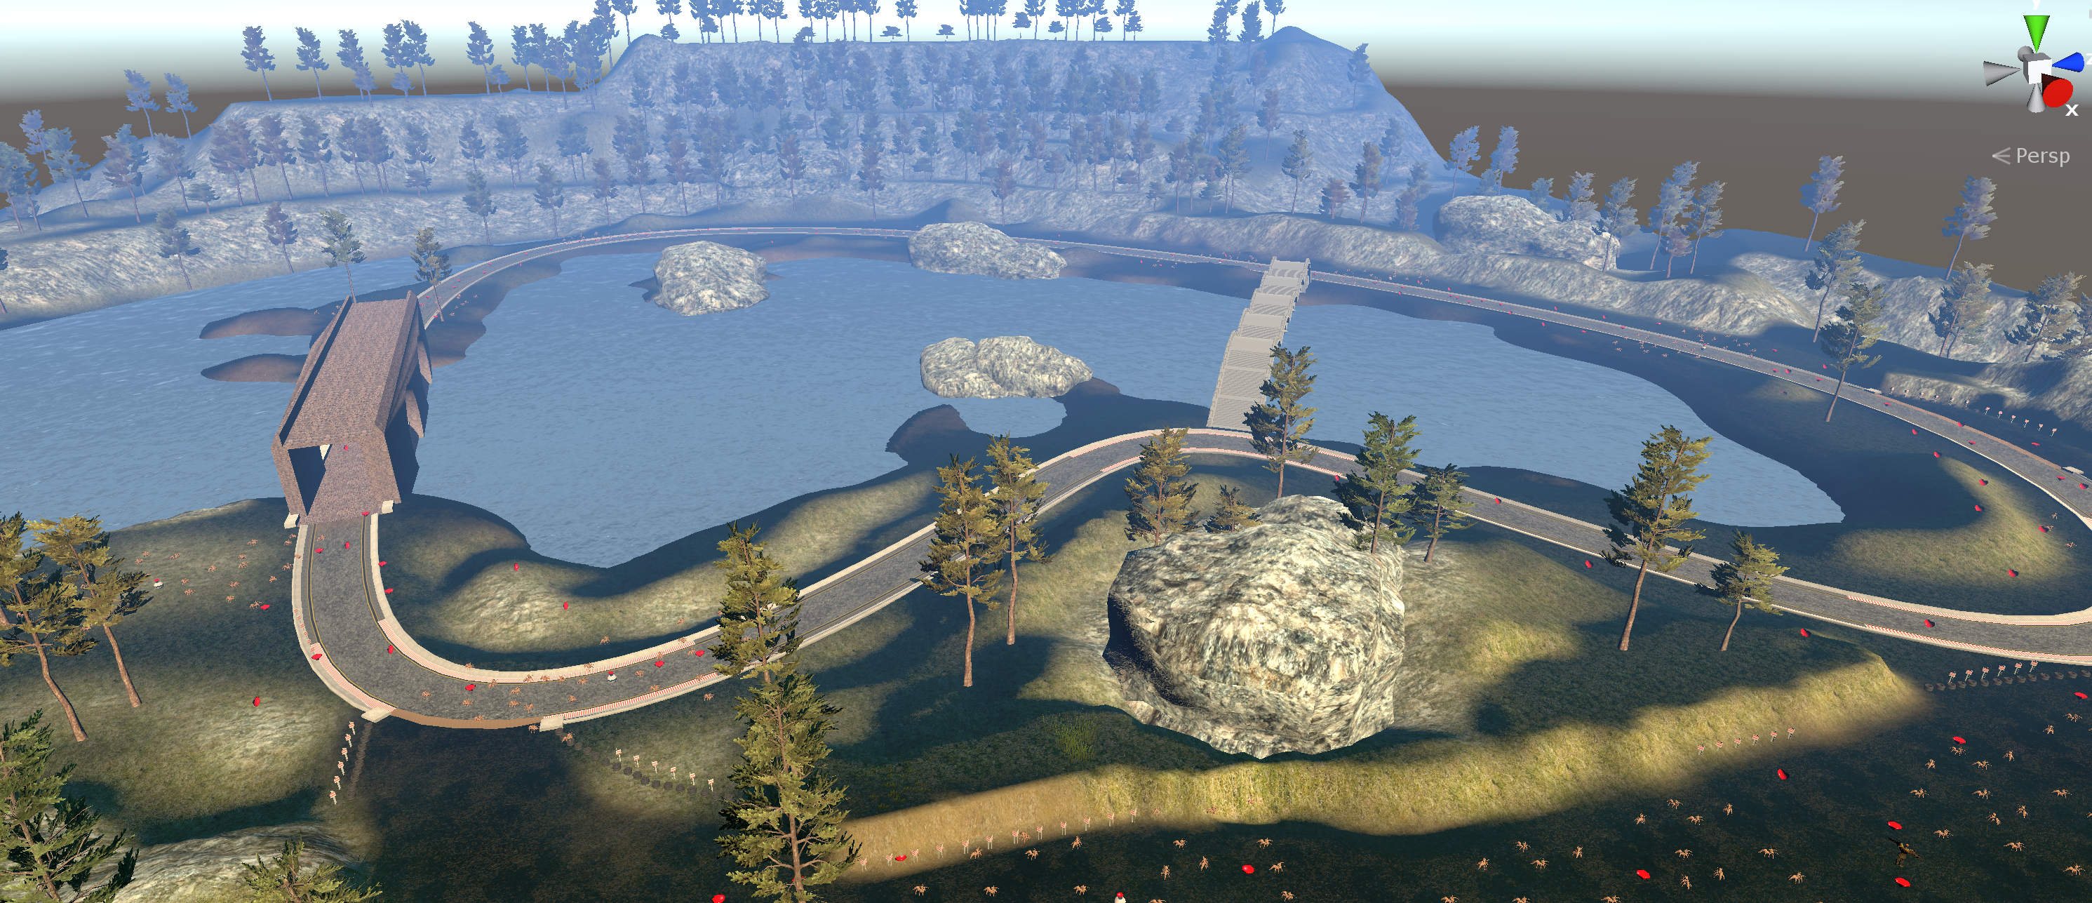
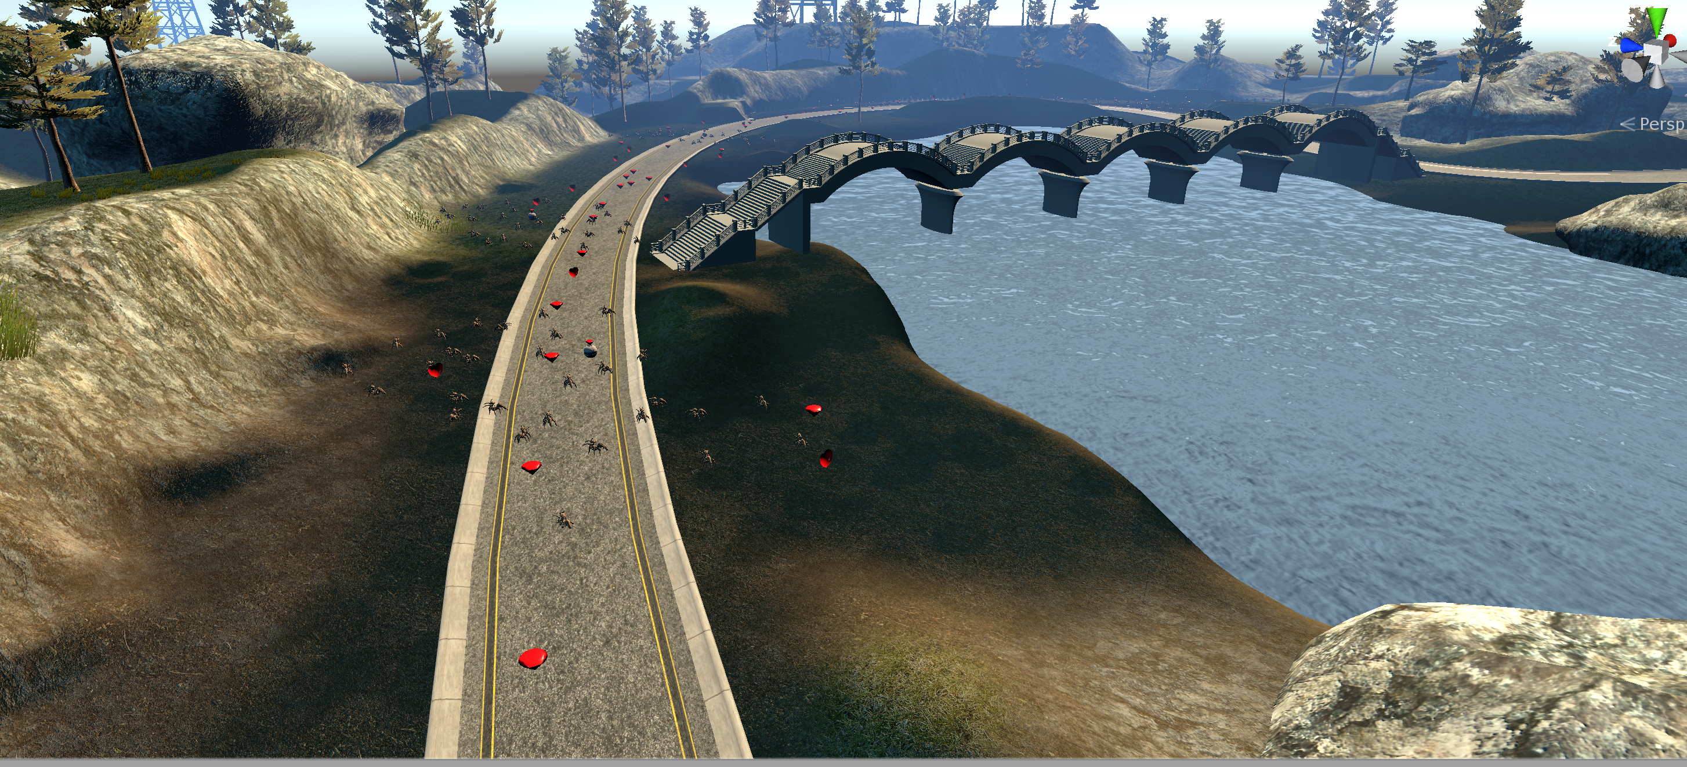
Environment

Slide 4
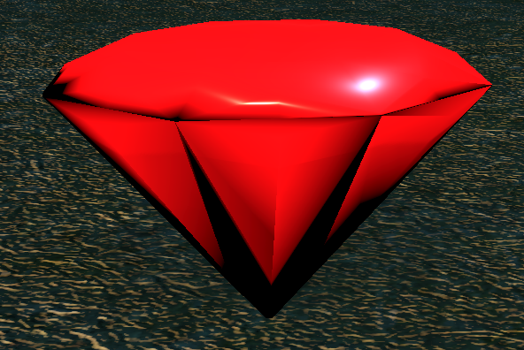
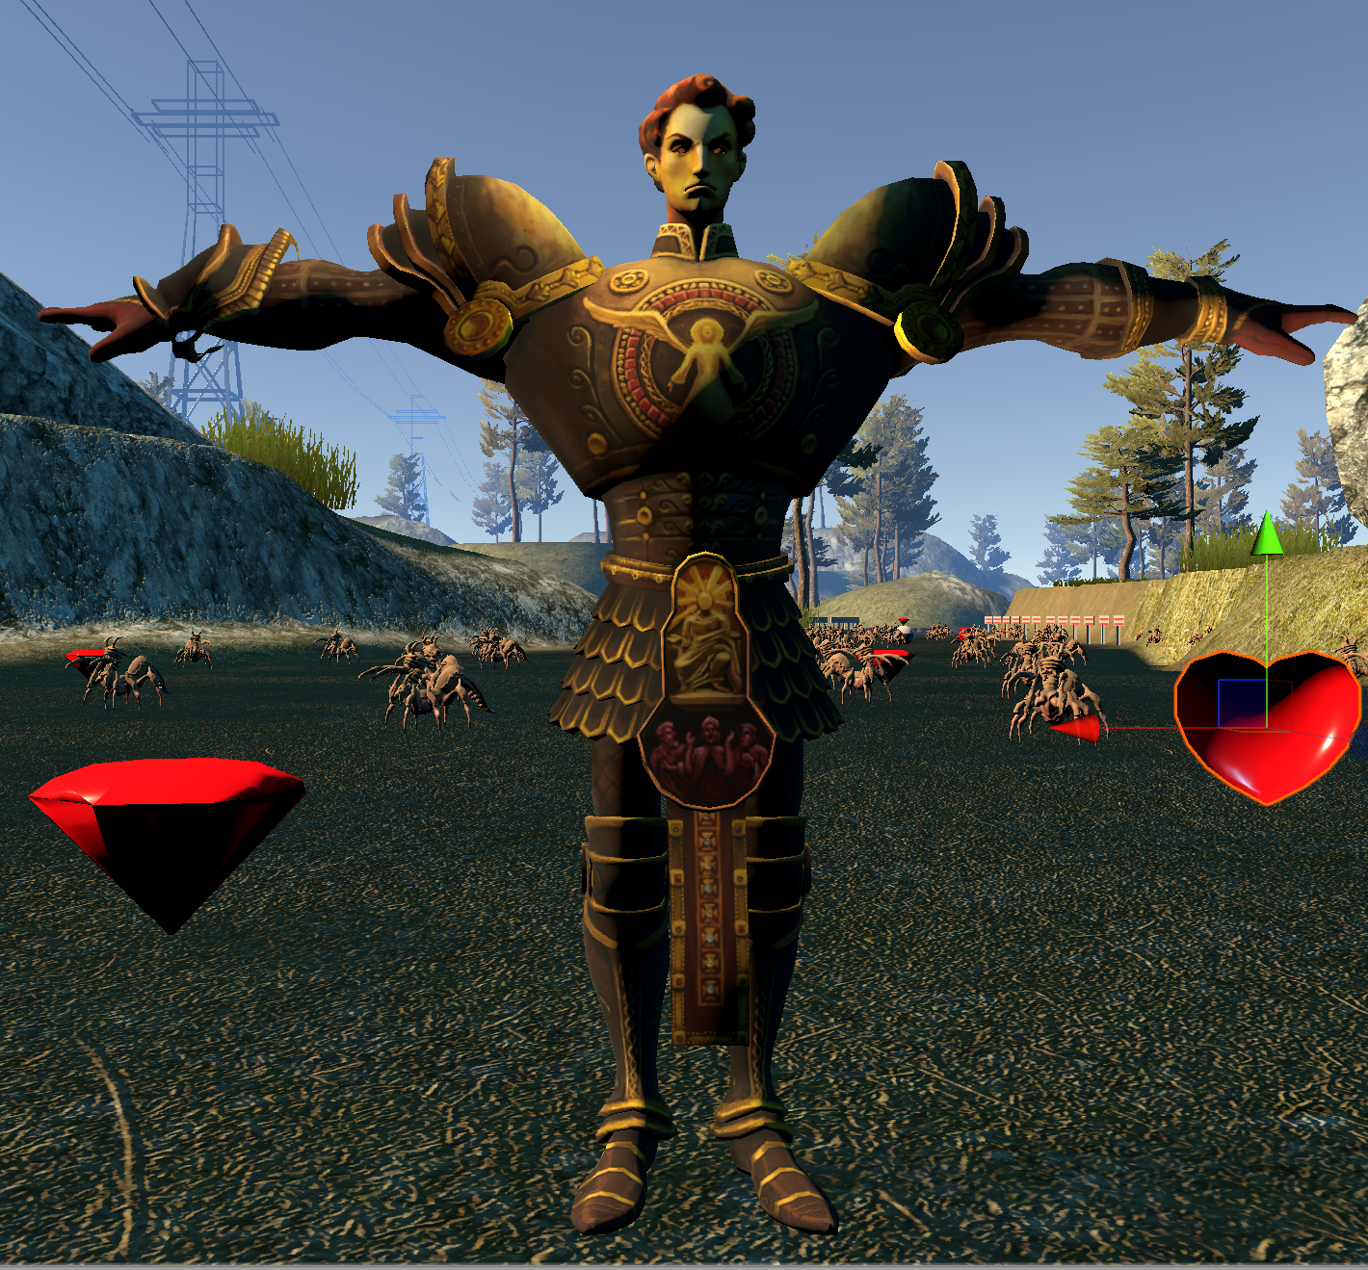
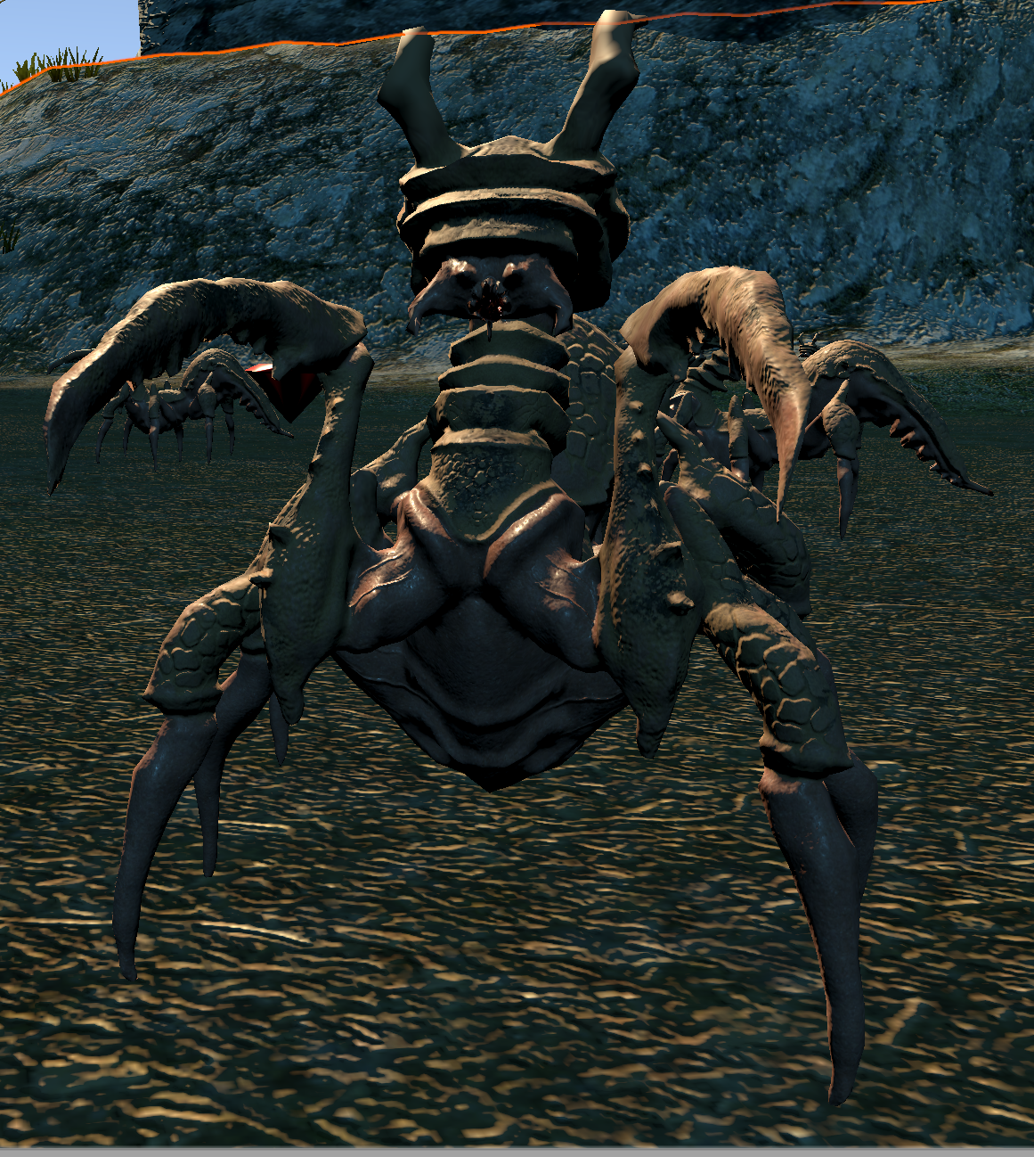
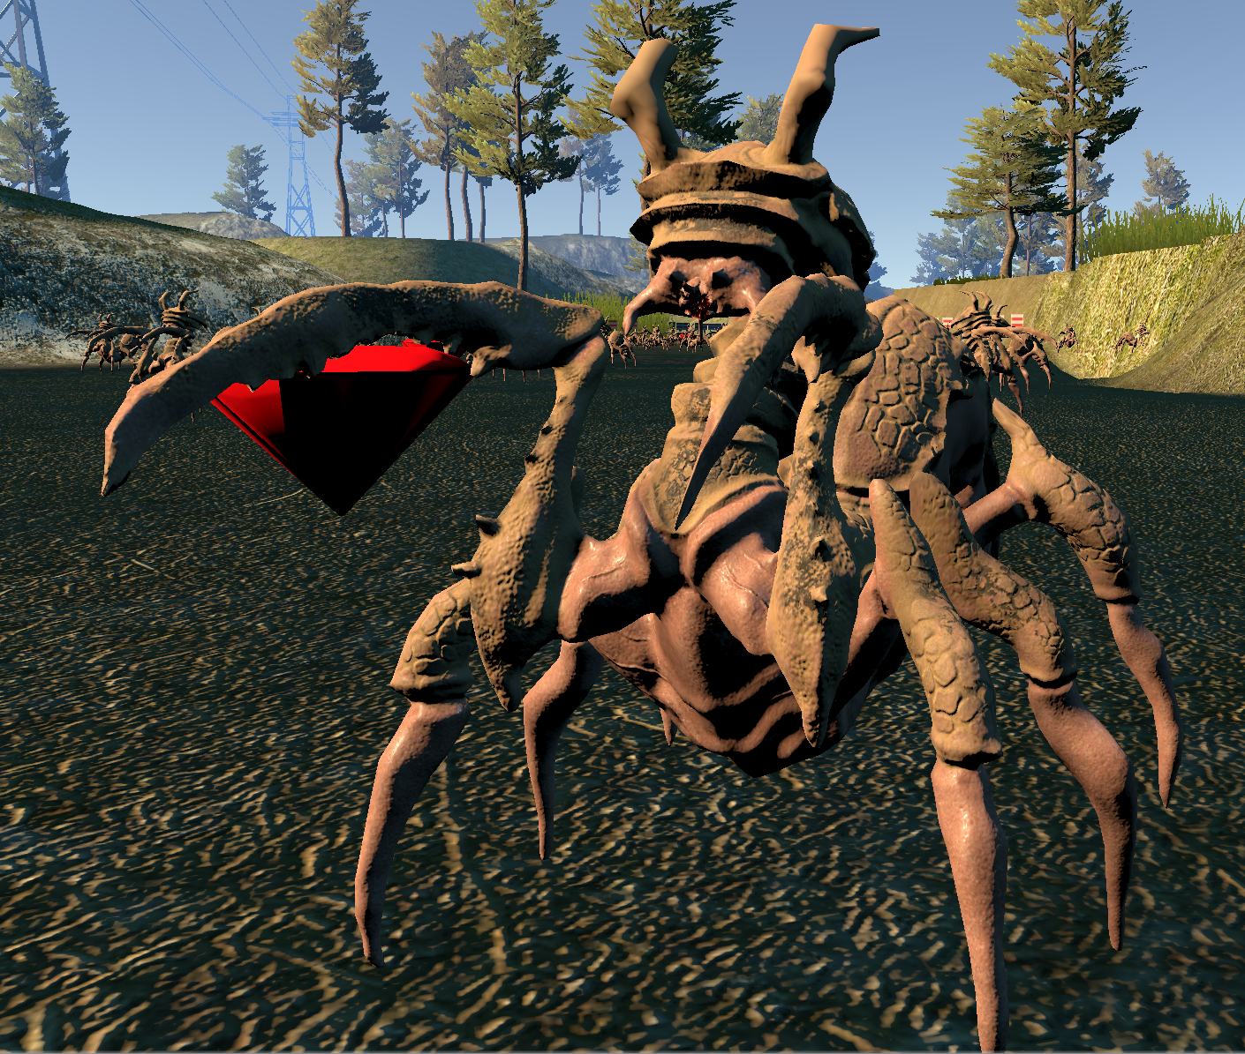
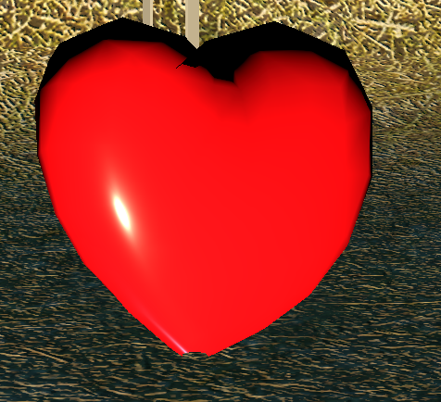
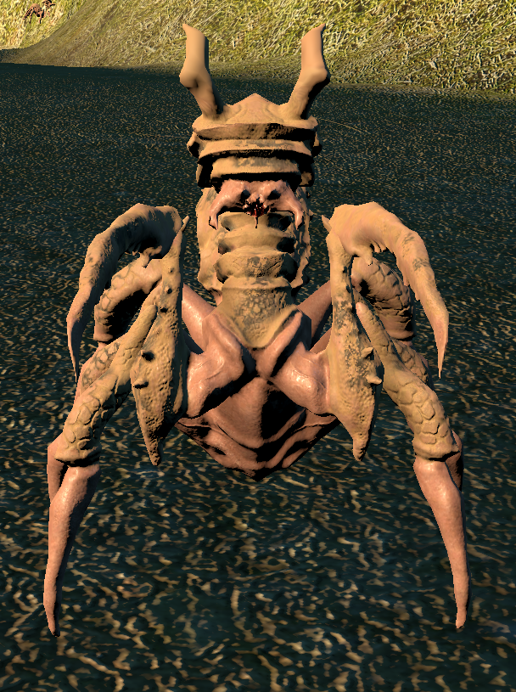
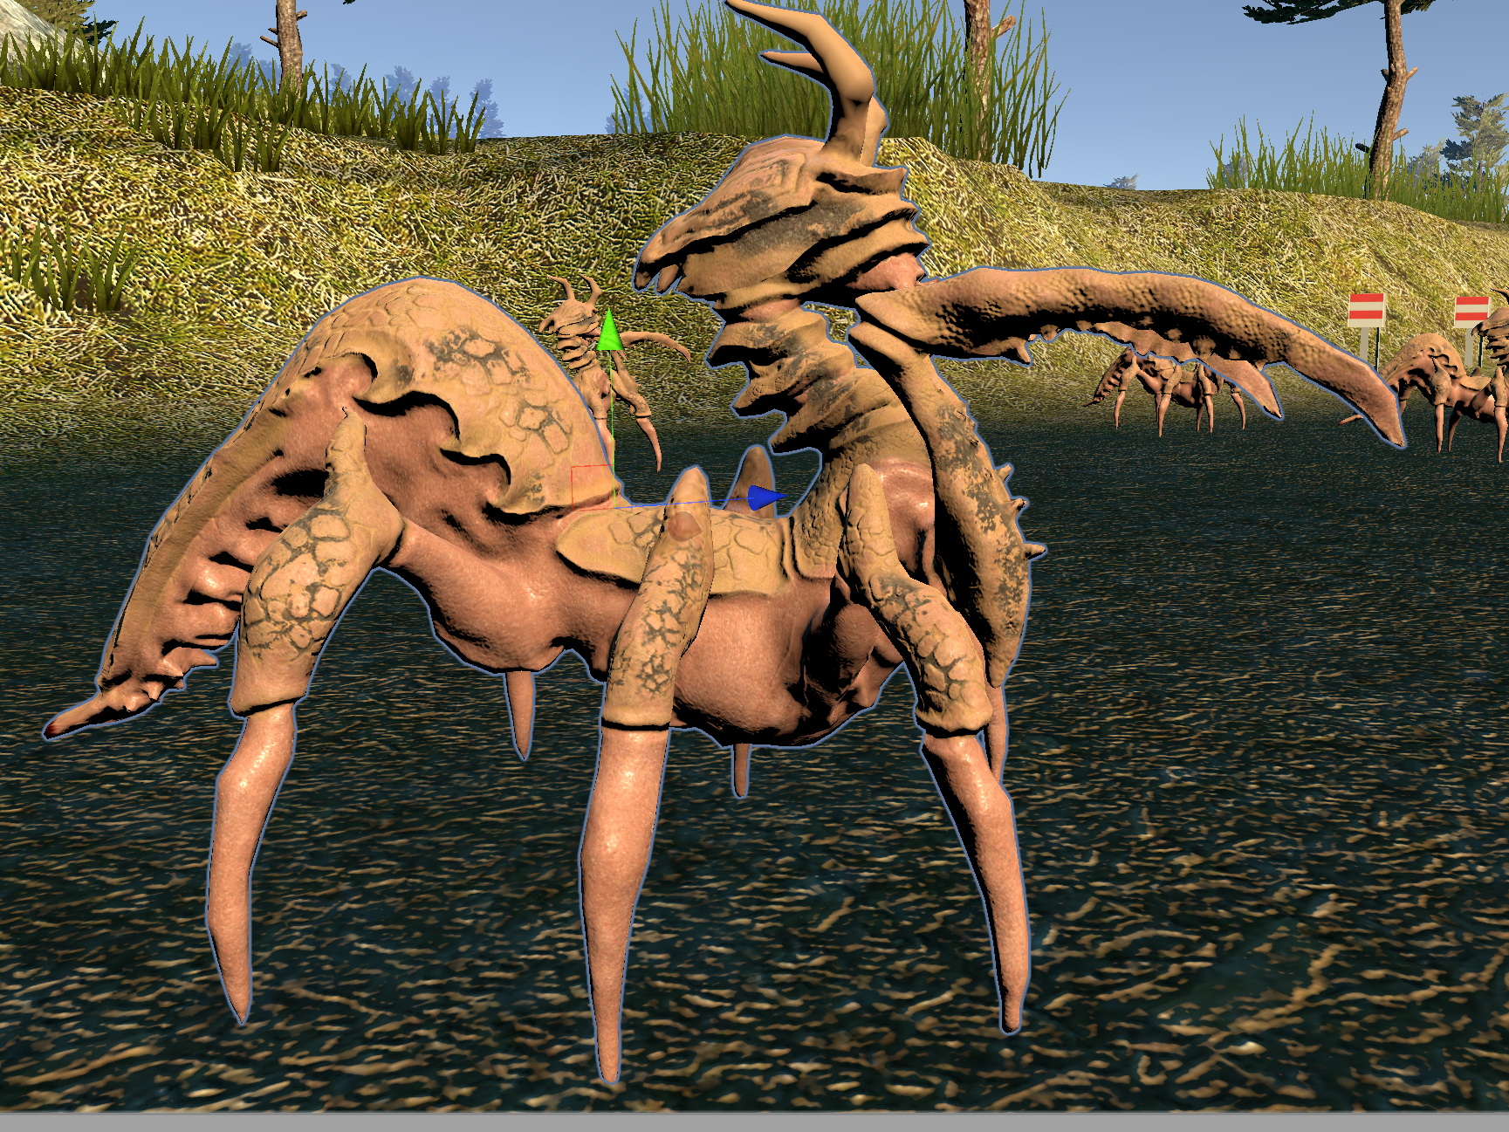
Modeling
Rewards
Enemies
Health
Player

Slide 5
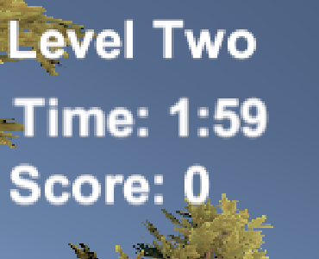
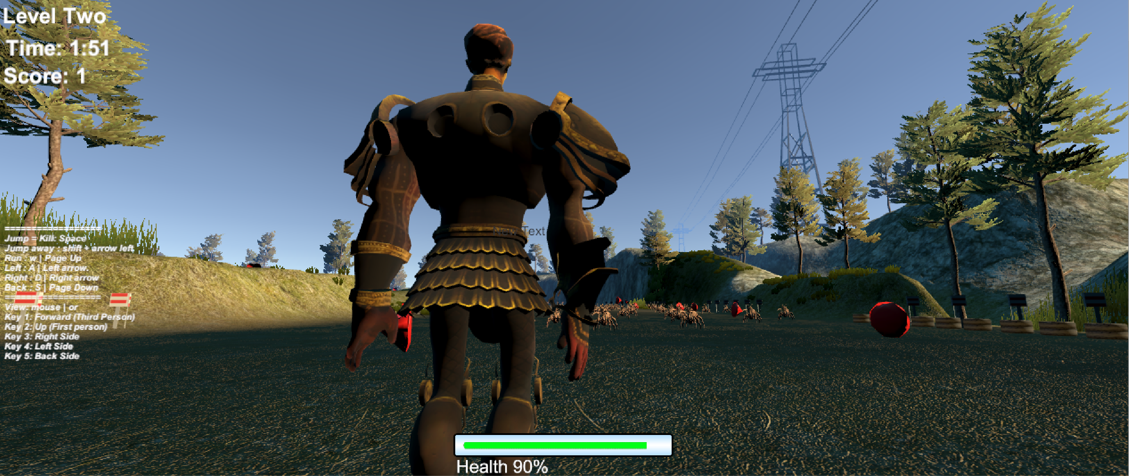
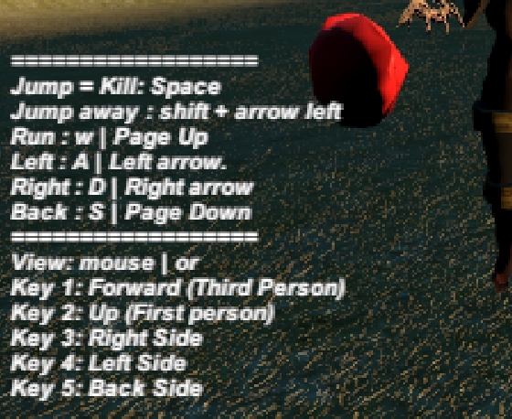
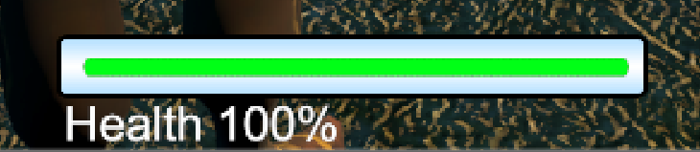
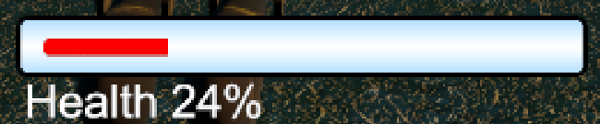
Time, Score, Health Bar, and instructions

Slide 6
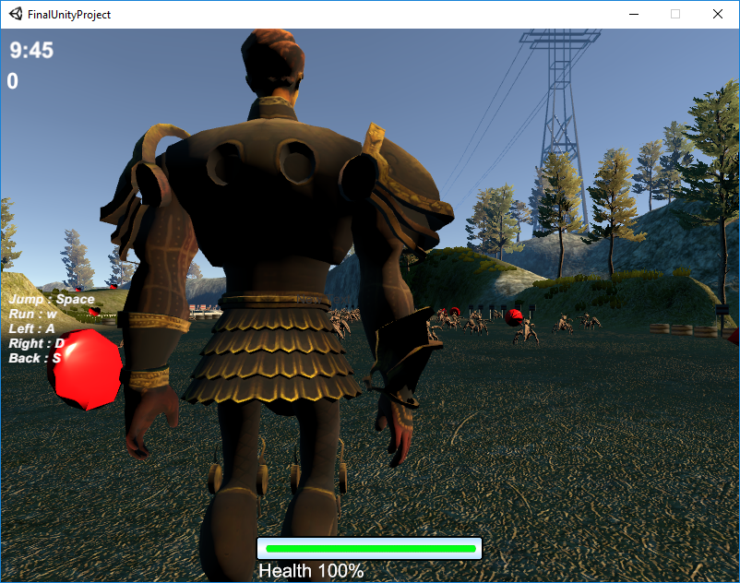
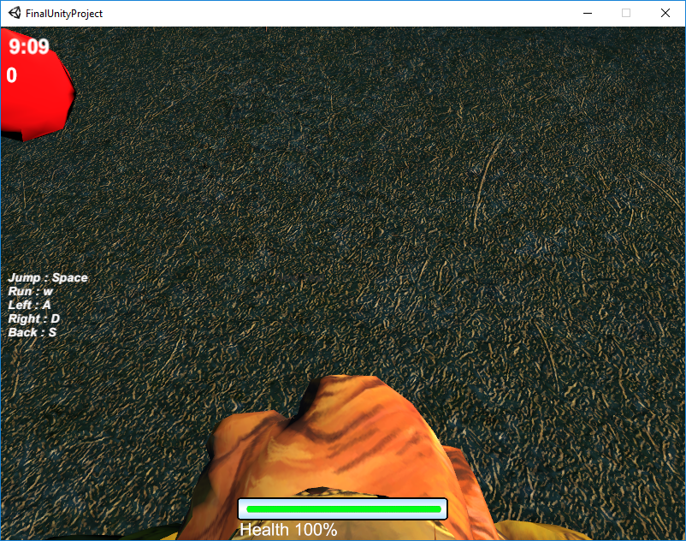
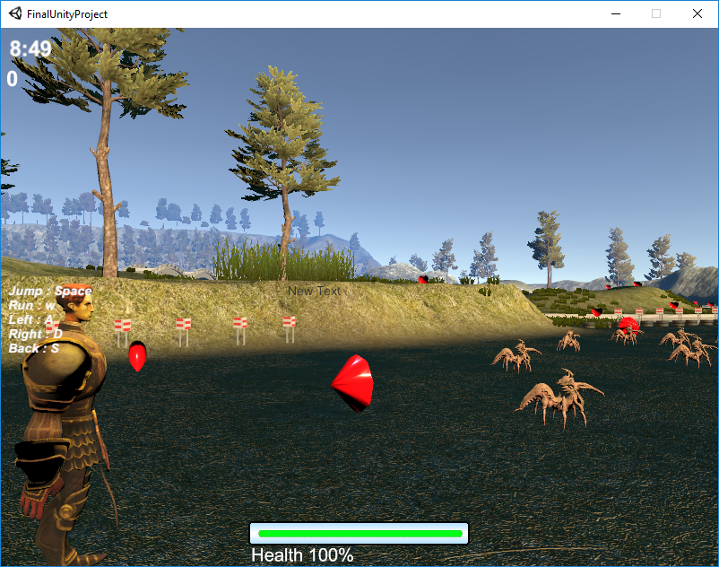
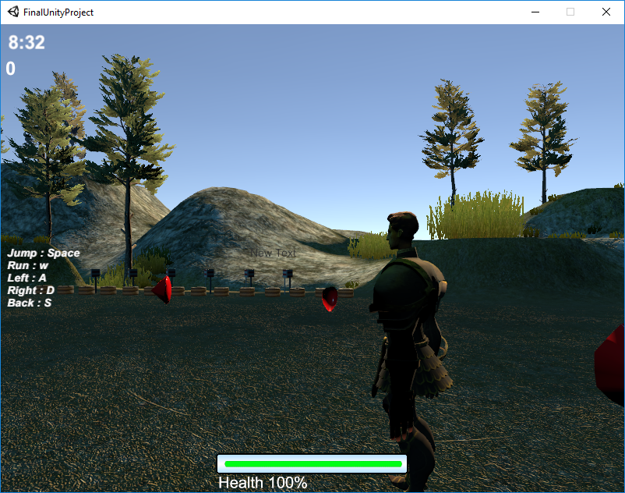
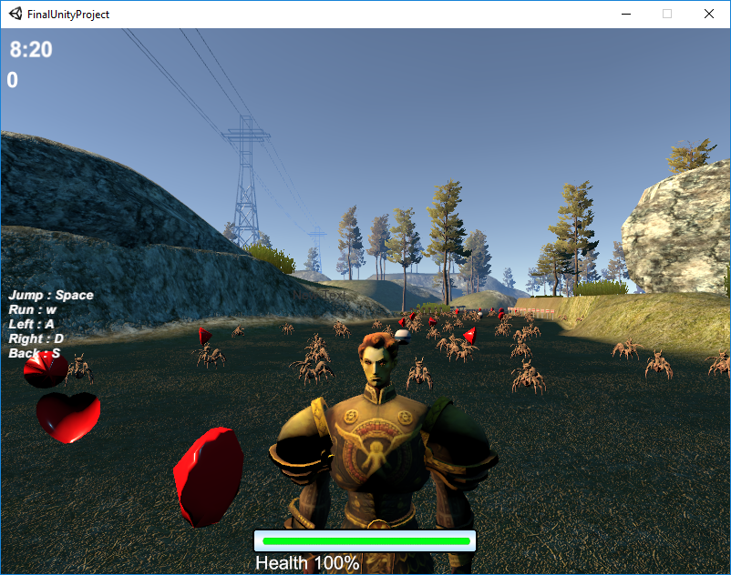
View Controls : mouse or keyboard
Key 1: Forward (Third Person)
Key 2: Up (First person)
Key 3: Right Side
Key 4: Left Side
Key 5: Back Side

Slide 7

Player Controls
Jump = Kill: Space
Jump away : shift + arrow left
Run : w | Page Up
Left : A | Left arrow.
Right : D | Right arrow
Back : S | Page Down

Slide 8

Sounds
Alert Health
Attack Enemy
Enemy Sound
Background Sound (fight Sound)
Death Enemy
Get Rewards
Get health
Win Sound
Defeat Sound
Jump
The End sound

Slide 9
Sensors
We used proximity sensors for enemies.
Time sensor for finishing levels
Collision detection and Touch sensors for enemies and collecting items.

Slide 10
Interactivity
We have multiple forms of interactivity:
Killing enemies
Collecting gems
Collecting health

Slide 11
Animations
We have models that have animations
The player has an idle, jumping, running animation.
Enemies have a moving animation
Gems have a spinning animation.

Slide 12
Levels
We have 2 levels in the game.
Level 1 is generally a simple version of the game so that the player can explore the world easier.
Level 2 is harder because there is less time and enemies do more.
Level requirements
Level Time Score+ Score- Health+ Health-
1 5 min. 1 1 1% 1%
2 3 min. 5 10 5% 10%

Slide 13
Important code
GameManager.cs
SendMessageUpwards("OnDeath");
BroadcastMessage("OnEnter", true ,SendMessageOptions.DontRequireReceiver);
Enemy.cs
public delegate void GetHealthPlayerAction(GameObject player);
public static event GetHealthPlayerAction OnGetHealthPlayer;
GameManager.cs
DamagePlayerEvent.OnDamagePlayer += DecrementPlayerHealth

Slide 14
DEMO

Slide 15
Thank you

